Slide 1
Recurrent Neural Networks: Text Prediction

Slide 2
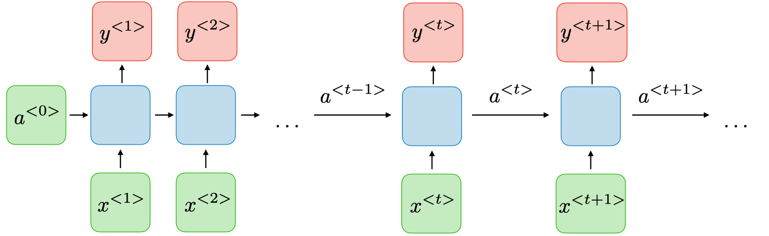
Recurrent Neural Network (RNN)
An RNN uses time series data to process inputs over a sequence of time, and output the next predicted value based on previous values
Used for any application that exhibits temporal dynamic behavior- or data that changes with time
Example: language recognition, both speech and text

Slide 3
RNN Advantages and Disadvantages
Advantages
Input can be any length
Model size doesn’t need to increase with larger input datasets
Can use historical data
Disadvantages
Slow network performance- takes time to compute output
Access to enough historical data

Slide 4
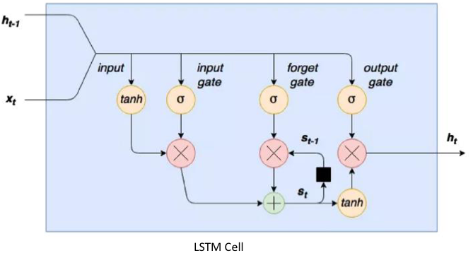
Methodology
Activation functions: Sigmoid and Tanh
Must account for vanishing/exploding gradient problem
Number of layers possible is limited
Solution: Long Short-Term Memory (LSTM) Cell
One LSTM cell is used as a replacement for a standard neural network layer

Slide 5
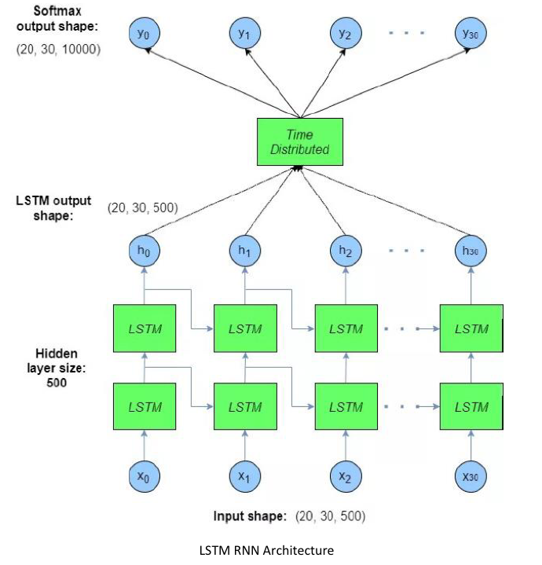
Architecture
Each input is mapped to at least one LSTM cell
Output of LSTM cell(s) are then manipulated to time domain
Softmax layer is used to derive the final output

Slide 6
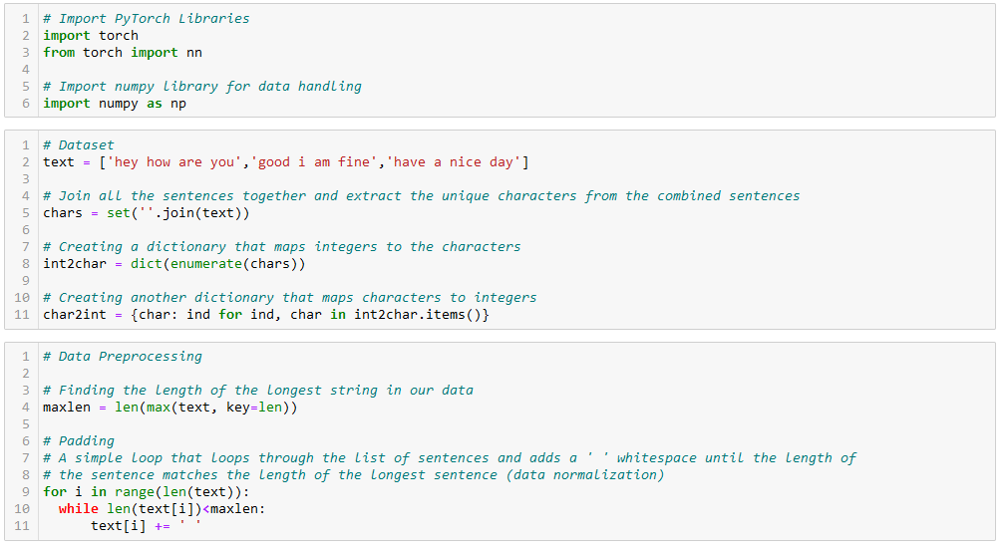
Text Prediction- RNN_Text_Template.py

Slide 7
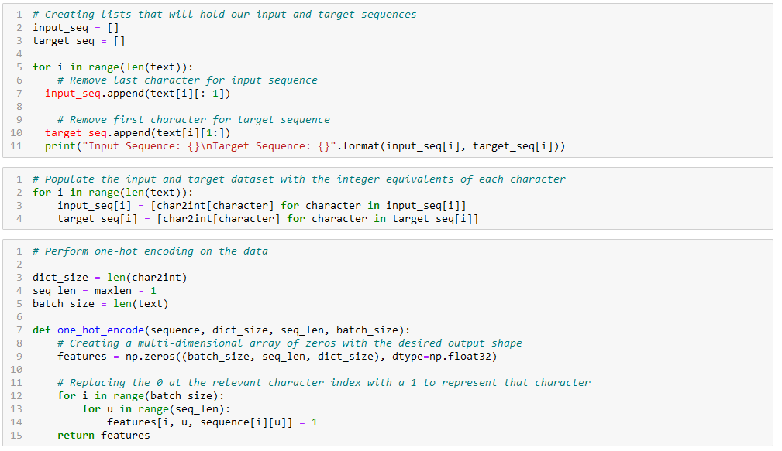
Text Prediction- RNN_Text_Template.py

Slide 8
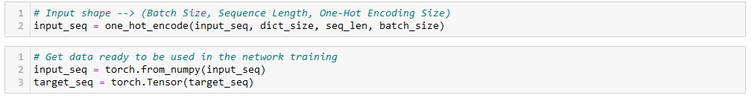
Text Prediction- RNN_Text_Template.py

Slide 9
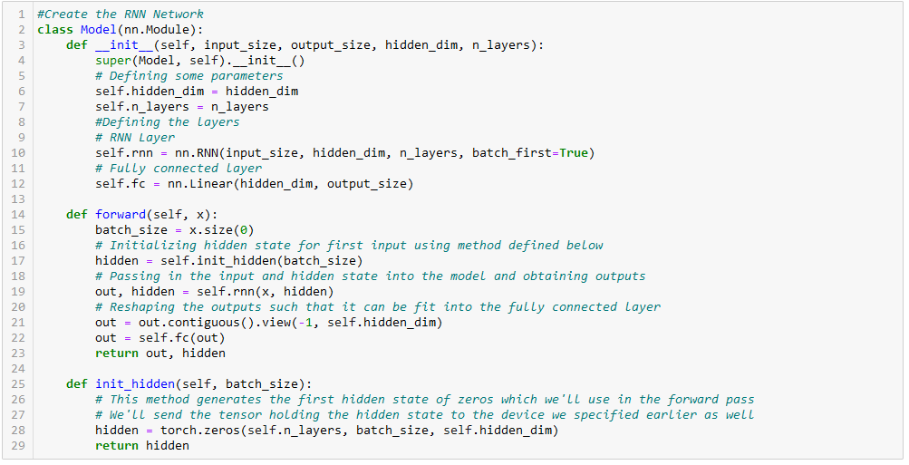
Text Prediction- RNN_Text_Template.py

Slide 10
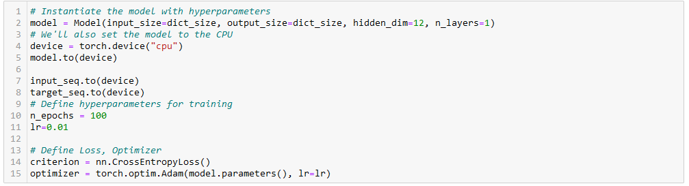
Text Prediction- RNN_Text_Template.py

Slide 11
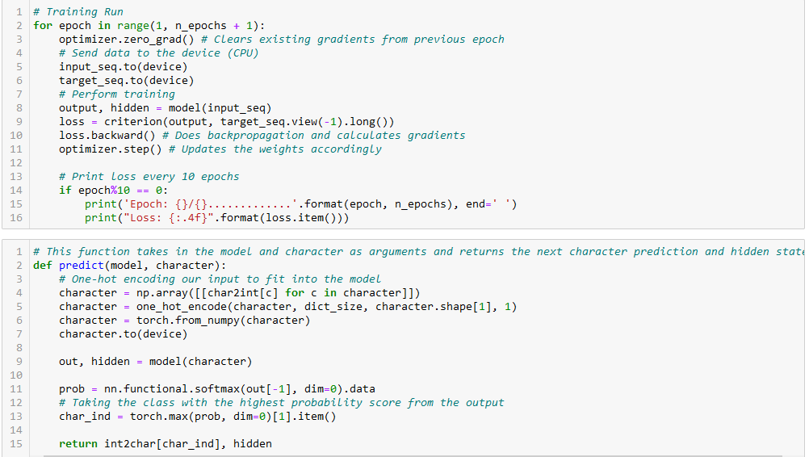
Text Prediction- RNN_Text_Template.py

Slide 12
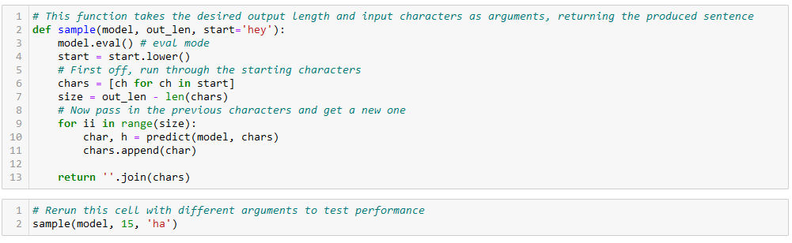
Text Prediction- RNN_Text_Template.py

